Slide 1

Quantum Risk Analysis
An Introduction
Lecture 3/3

Slide 2
01
Introduction
02
Quantum Computers
03
Risk profiling
04
Credit risk analysis
05
Classical Methods of Risk Analysis
Quantum Risk Analysis
06
Quantum Risk Analysis
07
Applying the quantum algorithm
Design by PresentationGO.com
08
Sources of Error
09
Advantages of Quantum Risk Analysis
10
Conclusions

Slide 3
08
Sources of Error
In this lecture
09
Advantages of Quantum Risk Analysis
10
Conclusions
Design by PresentationGO.com

Slide 4
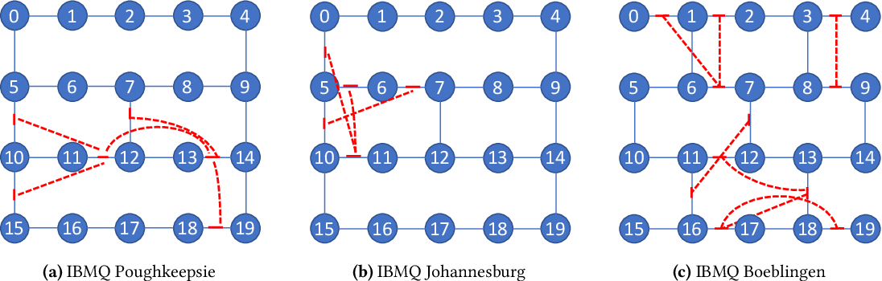
Sources of Error in the Quantum Algorithm
CNOT gate generator taking cross talk into account:
(19)
Cross talk measurement results for 3 different IBM Q systems.
(20)
https://www.nature.com/articles/s41534-019-0130-6
https://www.semanticscholar.org/paper/Software-Mitigation-of-Crosstalk-on-Noisy-Quantum-Murali-McKay/b33e5737579a3c5483cf87d472f8a92de7dd9ca3
8

Slide 5
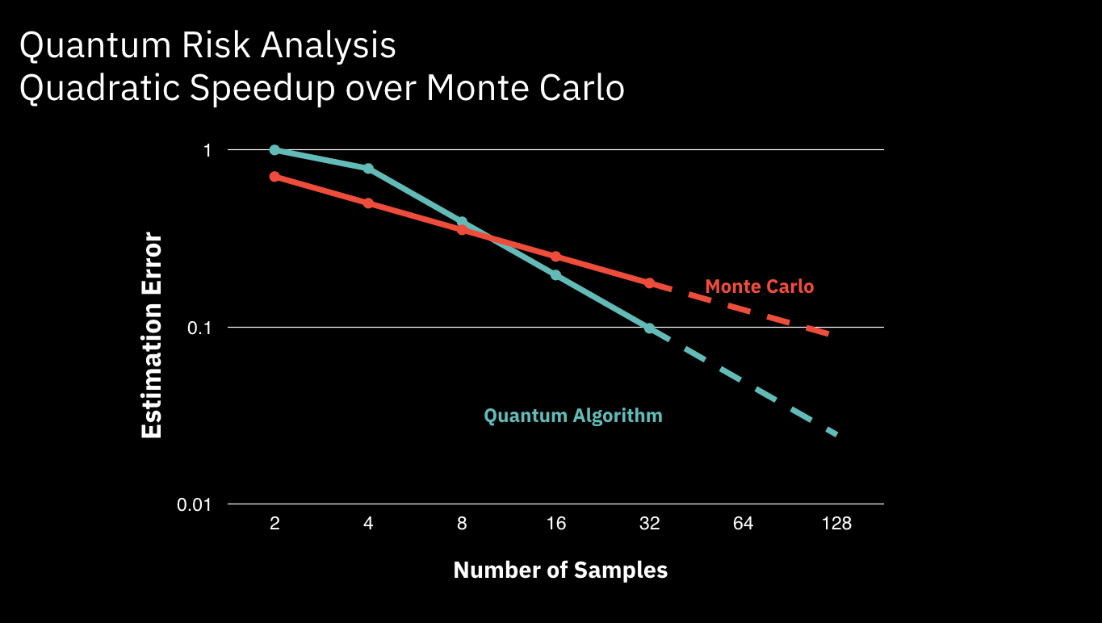
Advantages of Quantum Risk Analysis
Comparison of the convergence of the error of the Quantum Algorithm and Monte Carlo simulation for number of samples M (where M=2^{m}):
(21)
8
https://www.ibm.com/blogs/research/2019/03/quantum-risk-analysis/

Slide 6
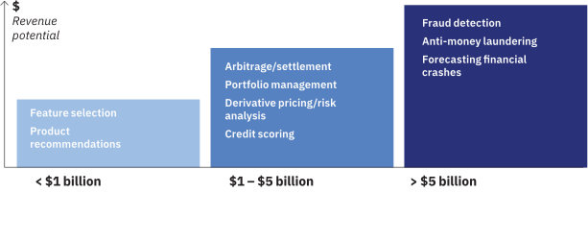
Conclusions
(22)
https://www.ibm.com/thought-leadership/institute-business-value/report/exploring-quantum-financial

